Slide 1

DATA-603 Fire Incident Dispatch Analysis Using PySpark
Koushal Vanam
Shiva Teja Chintala

Slide 2
Problem Statement/Objective
Fire incidents pose significant challenges to urban areas, necessitating prompt response and effective management to mitigate potential damage and ensure public safety.
This data analysis project aims to analyze the fire incidents in New York City, utilizing a large dataset spanning several years. We aim to use this dataset to find important trends, insights, and possible areas where fire incident management could be improved.

Slide 3
Dataset Overview
Source: The dataset was taken New York city fire department
Size: 2.62 GB
Data Volume: No. of rows : 8691523, No. of columns: 12
Period Covered: 2007 – 2021
The data provided is in CSV format which is in a semi-structured format
Challenges: Variable formats across different year
Addressing missing or incomplete information

Slide 4
Preprocessing
Loaded the data from the CSV file
Defined and applied the spark schema.
Removing Missing Values: To assess data accuracy, we counted the number of null values before and after removing missing values.
A few columns that weren't needed for analysis were dropped.
To obtain accurate data, we calculated mode values for some columns and replaced null values with mode values.
Converted column data types form string to int and one column to timestamp to make analysis easier.
Dropped the duplicate rows.

Slide 5
Exploratory Data Analysis(EDA)
This report contains a thorough exploratory data analysis (EDA) of the New York City Fire Incidents dataset. The analysis aims to uncover patterns, trends, and insights that will help us better understand fire incidents and emergency response strategies.

Slide 6
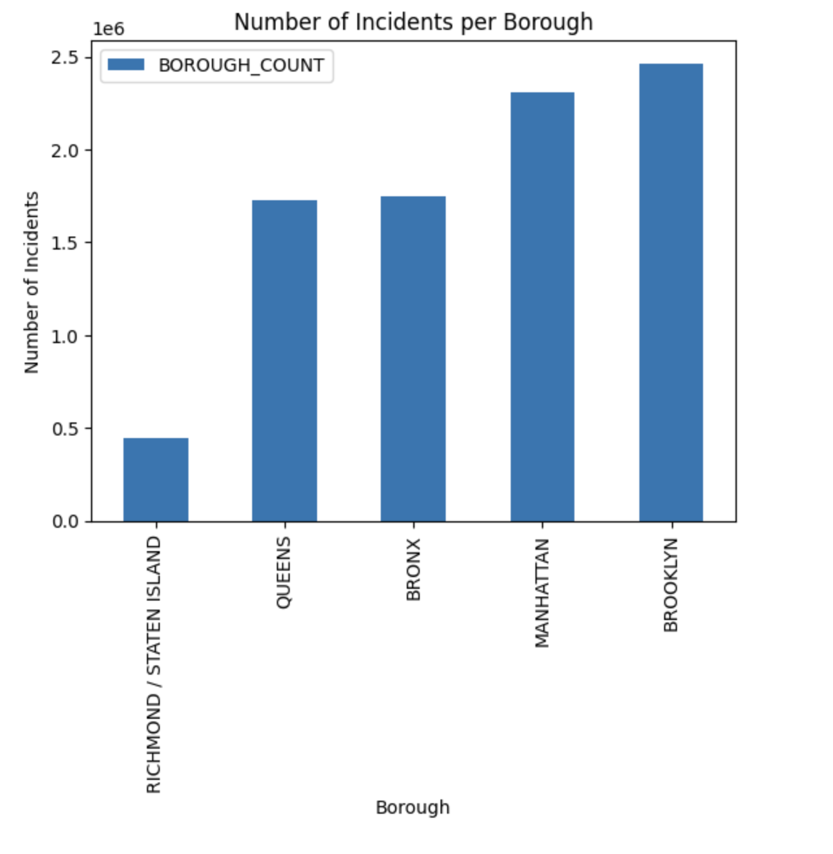
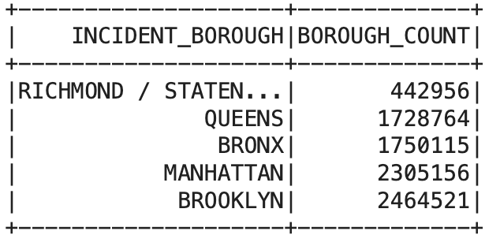
Visualizations
Highest Number of Incidents by Borough:

Slide 7
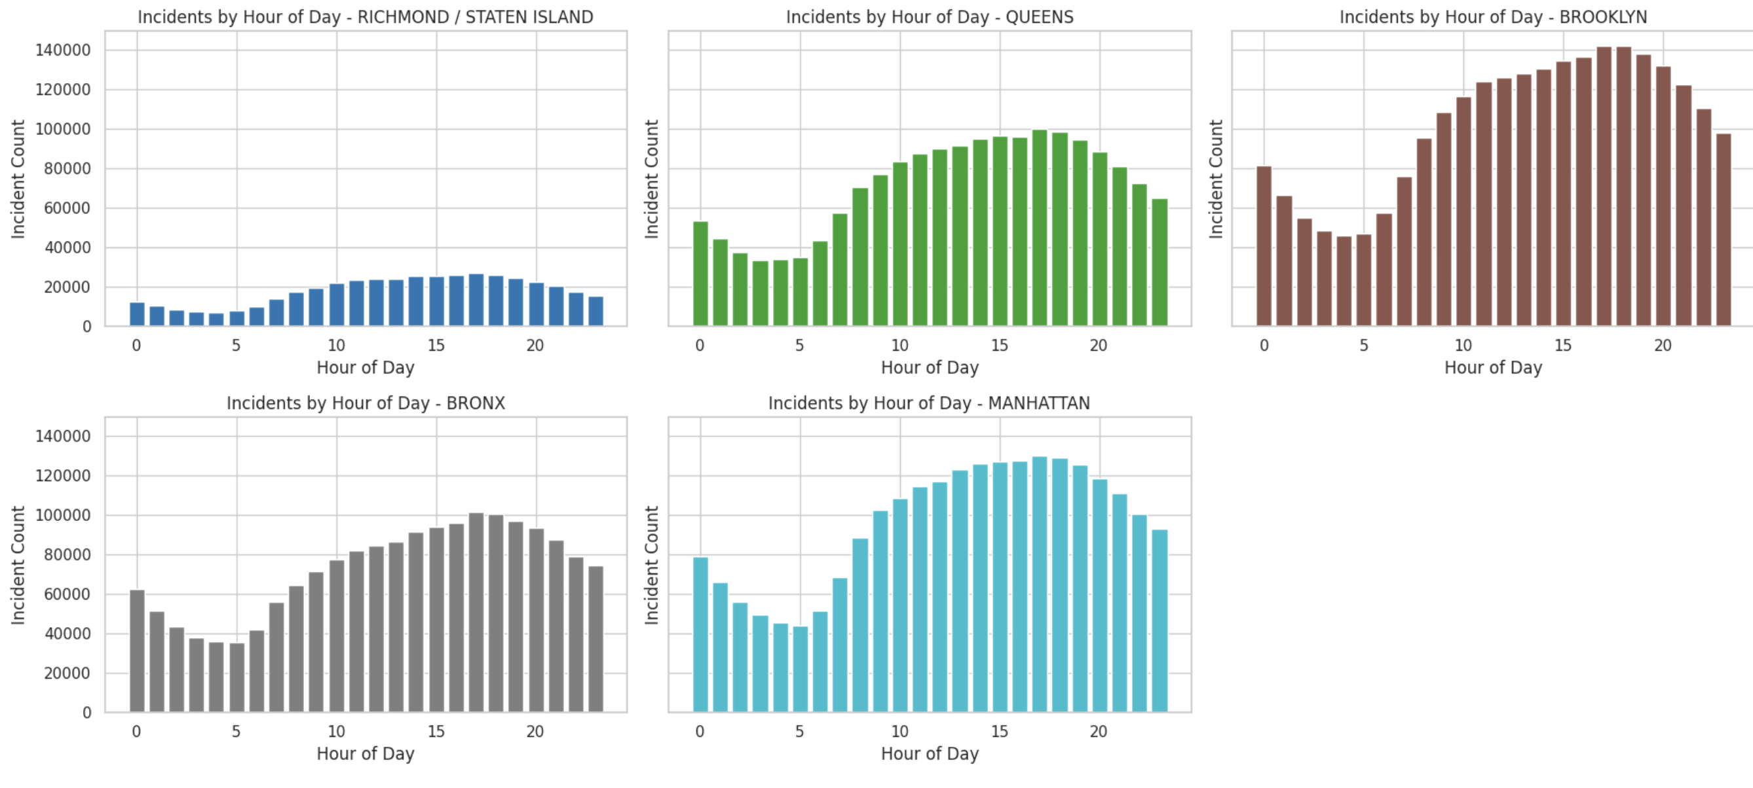
Time Series Analysis
Visualizing incidents by Hour

Slide 8
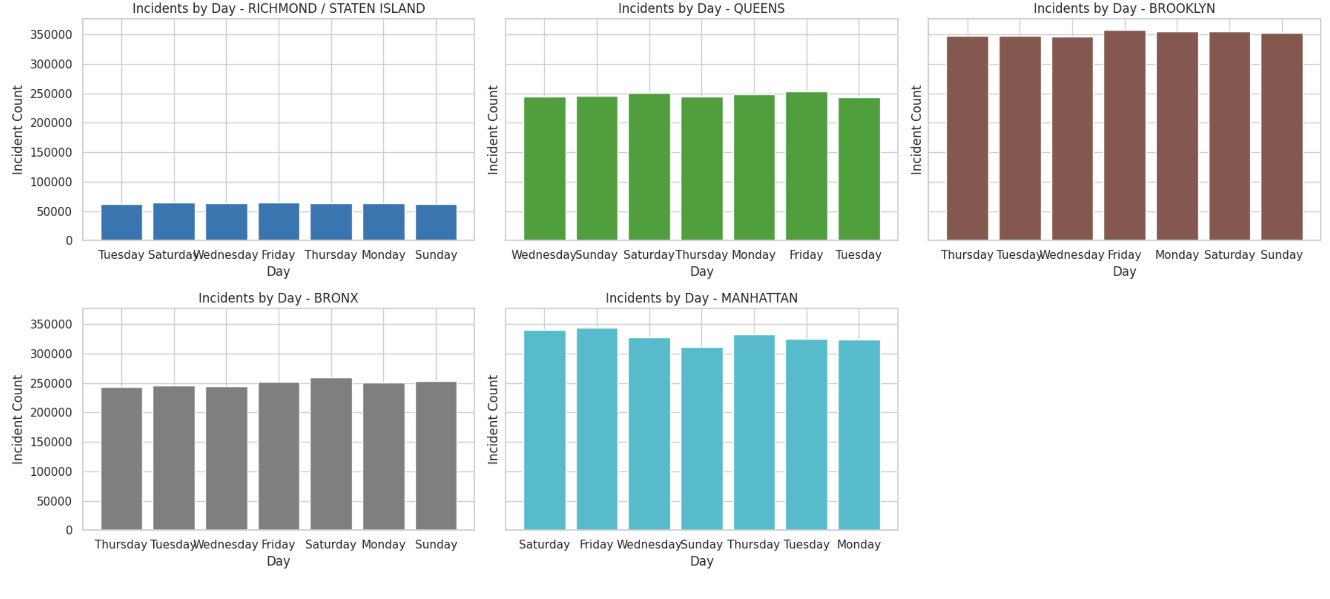
Time Series Analysis
Visualizing incidents by Day

Slide 9
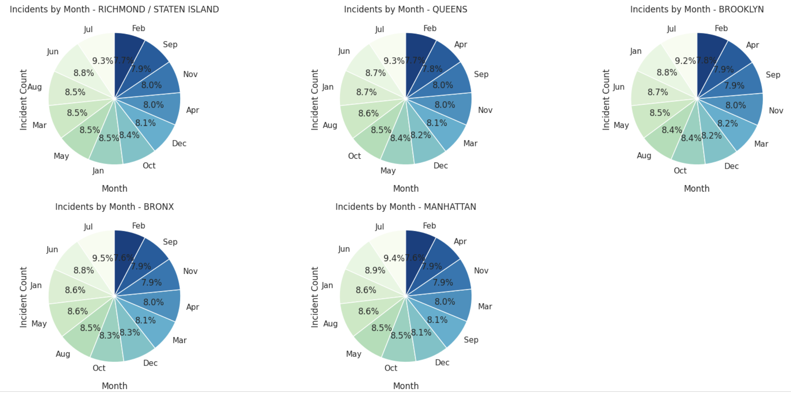
Visualizing incidents by Month

Slide 10
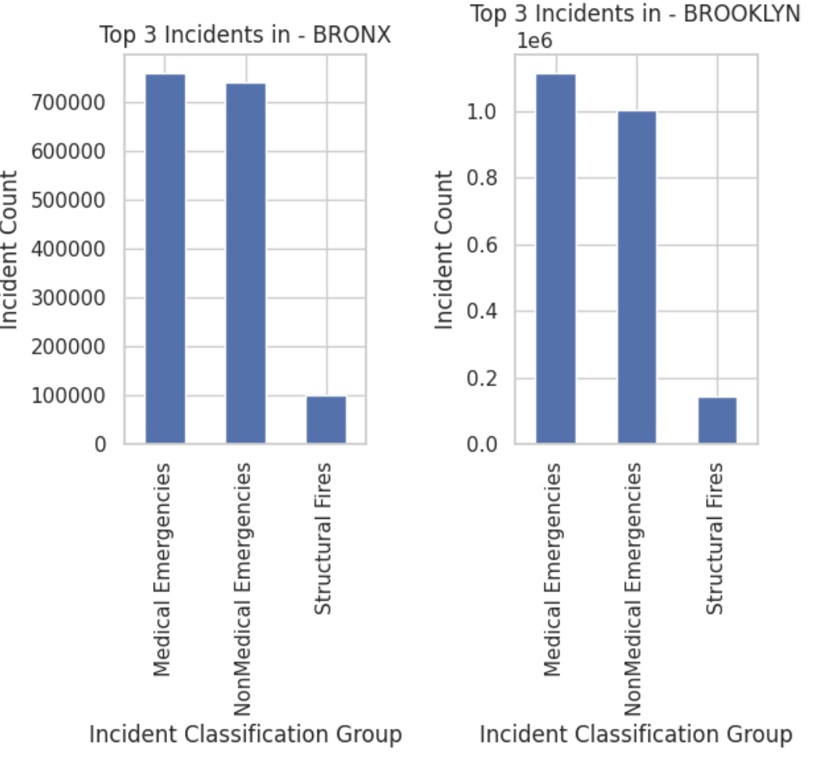
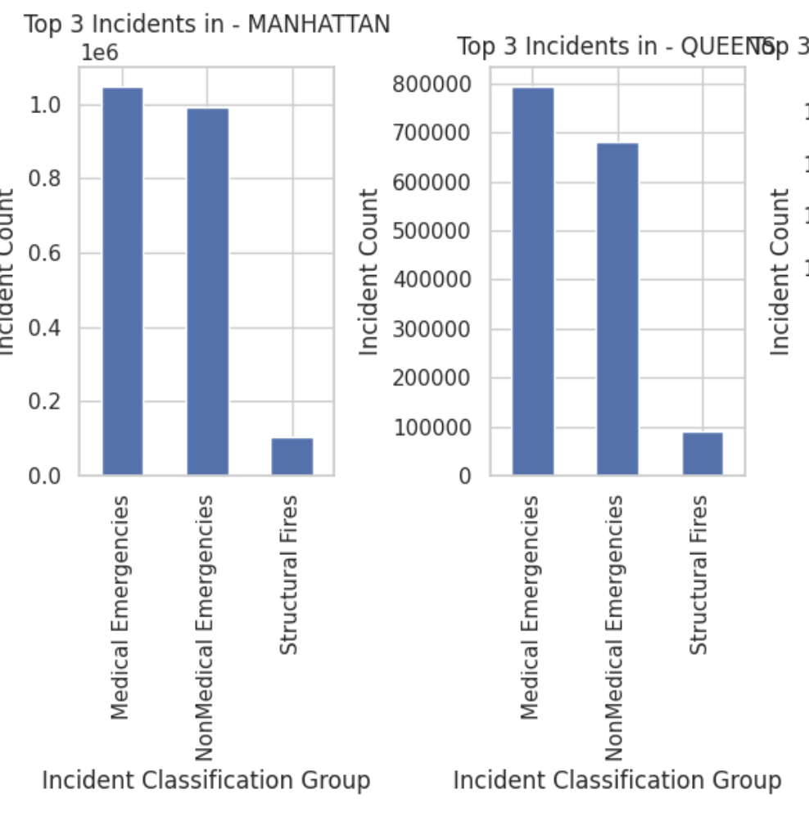
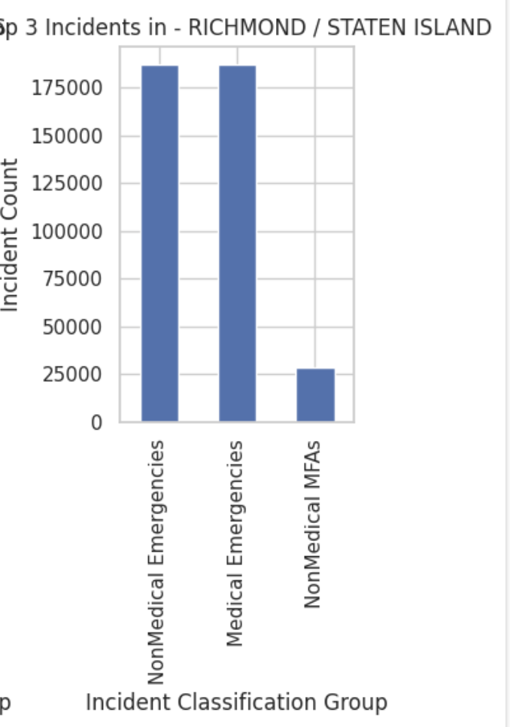
Top 3 most identified type of incident classification group

Slide 11
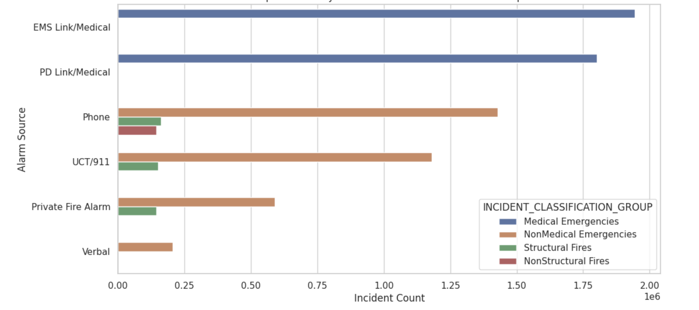
Top incidents by Alarm source and Classification group

Slide 12
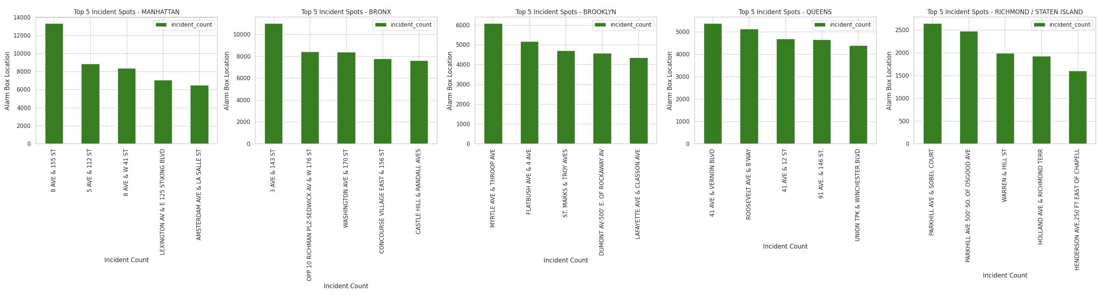
The top five incidents in each borough based on alarm box location.

Slide 13
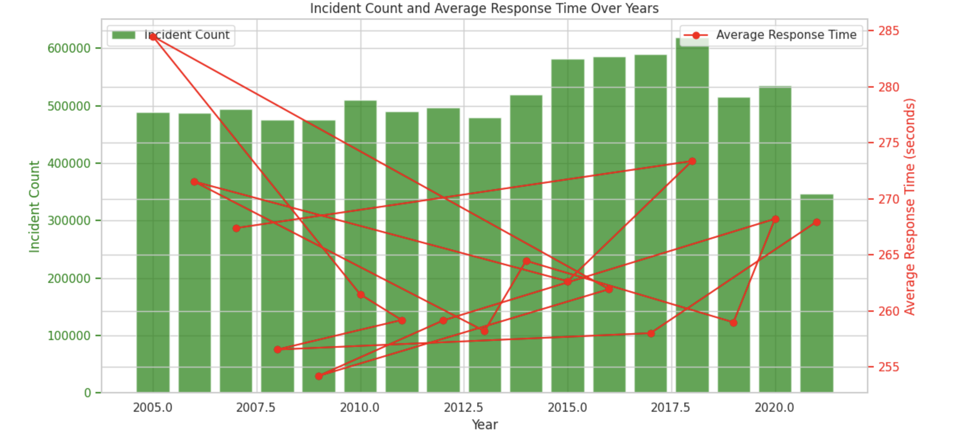
Incident count and average response time over years

Slide 14
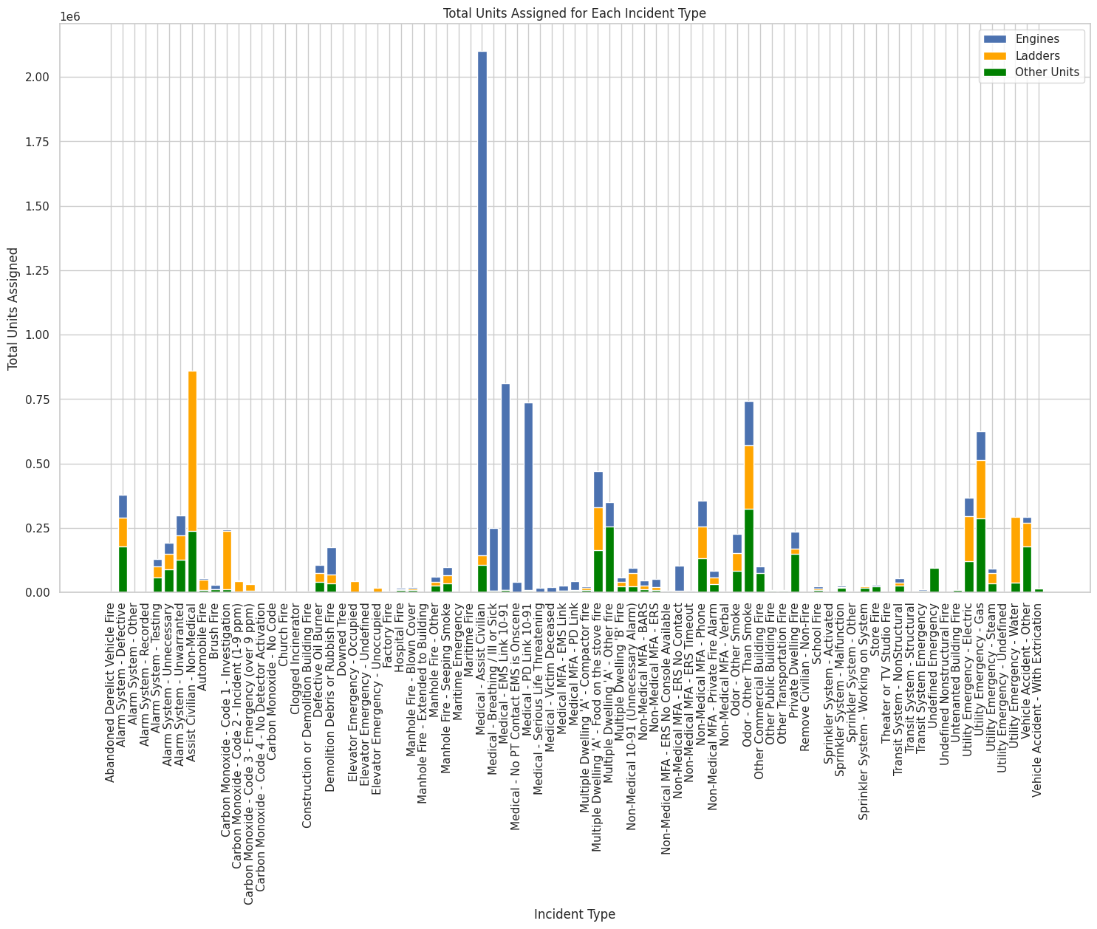
Total units assign for incidents

Slide 15
Key Findings
Brooklyn was identified as the borough with the highest number of fire-related emergencies, implying a potential need for increased resource allocation in this area.
The hours of 5 and 6 p.m. are the busiest for fire incidents, and July is the month with the most incidents overall. By allocating sufficient resources during these hours, emergency services can greatly enhance their overall efficiency and response times.
In 2018, there was a significant increase in incidents. More research is needed to determine the factors that are causing this surge. Understanding the reasons for such fluctuations can help inform strategic planning and policy decisions, ensuring that emergency response capabilities are adaptable to changing conditions.
The analysis showed that medical emergencies outnumbered structural fires, highlighting the importance of collaborating with health services to develop a more comprehensive emergency response strategy.

Slide 16
Conclusion
In conclusion, the New York City Fire Incidents dataset's exploratory data analysis (EDA) provided valuable insights into the patterns, trends, and challenges associated with fire incidents across the city's boroughs. The analysis revealed distinct time variations, highlighting the need for targeted and adaptive strategies to improve emergency services and public safety.
Future work: Future work involves developing predictive models for fire incidents, integrating real-time data sources, and exploring community-specific strategies.

Slide 17
THANK YOU

